Slide 1


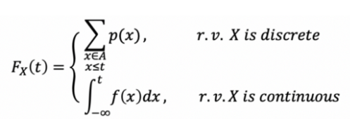

Recap
Probability Mass Function (PMF) :
Probability Density Function (PDF) :
Cumulative Density Function (CDF)
Joint Probability Density Function

Slide 2
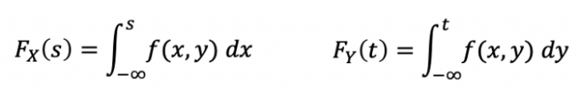

Marginal Probability Density Function
Joint Cumulative Density Function

Slide 3



Joint Probability Mass Function
Marginal Probability Mass Function
Definition of Independent Random Variables

Slide 4
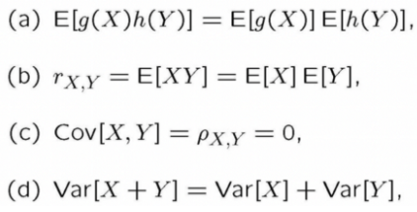
Properties of Independency

Slide 5








Transformation of random variable
pdf
Let, X = random variable
C= constant (positive)
Y= new random variable
Let us assume that we have probability density function for variable X
Probability density function of Y?
We have to consider an event that y lies in some segment.
+c
x
x
if
so

Slide 6
At the time of transformation, this segment shifts by adding the constant c.
we get a new segment, As these two events occur simultaneously, their probability equals
In the same way, probability of this event is involved in the definition of probability density function for random variable Y.
the whole graph 1 of probability density function is shifted to the right if c is positive exactly by adding plus c to all X coordinates.
So, in the new graph, we can see that it is a shifted version of this old graph.

Slide 7

And to connect this probability with probability of this event,
we have to put . Now, we can move this c out of the limit sign.
We see here probability of this event and this event is the same as this event.
If we replace, here, this probability by this probability we will get probability density function of X at point x small.
these two probability density function are related with the following transformation.
First, we have to stretch the figure horizontally by multiplying X by c.
And second, we have to squeeze the graph vertically by multiplying the value of the function by 1 over c.
The fact that we have to compensate expanding in horizontal direction by contraction in vertical direction preserves the probability of getting somewhere or in other sense, the area under this curve to be equal to one.
  So for this curve, area under the curve is equal to one because
    it is probability density function.
    And the same holds for the new curve
      because the expansion in horizontal direction is compensated by contraction in the vertical direction.

Slide 8




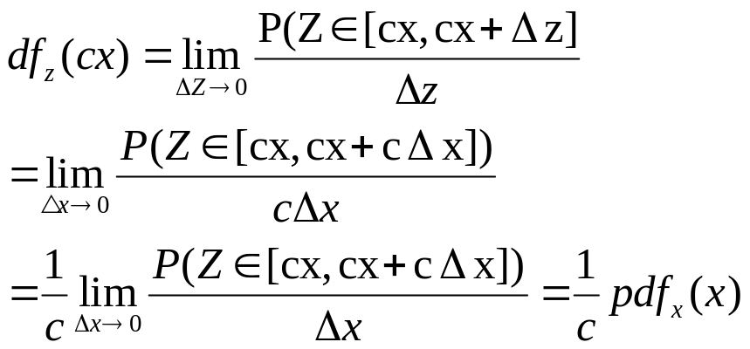
If this graph is a graph PDF for X. What is the probability density function for Z?
Consider two events
pdf
As,
so,
x
x
Contrast of the previous case, the length of the new segment is different from the length of the initial segment.

Slide 9
Probability functions
A probability function maps the possible values of x against their respective probabilities of occurrence, p(x)
p(x) is a number from 0 to 1.0.
The area under a probability function is always 1.
Example :
1. What’s the probability that you roll a 3 or less?
P(x≤3)=1/2
2. What’s the probability that you roll a 5 or higher?
P(x≥5) = 1 – P(x≤4) = 1-2/3 = 1/3
Notes:
It turns out that if you were to go out and sample many, many times, most sample statistics that you could calculate would follow a normal distribution.
What are the 2 parameters (from last time) that define any normal distribution?
Remember that a normal curve is characterized by two parameters, a mean and a variability (SD)
What do you think the mean value of a sample statistic would be? The standard deviation?
Remember standard deviation is natural variability of the population
Standard error can be standard error of the mean or standard error of the odds ratio or standard error of the difference of 2 means, etc. The standard error of any sample statistic.

Slide 10

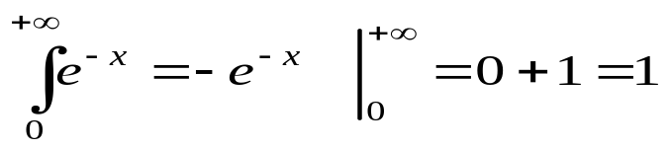
Continuous random variable
The probability function that accompanies a continuous random variable is a continuous mathematical function that integrates to 1.
The probabilities associated with continuous functions are just areas under the curve (integrals!).
Probabilities are given for a range of values, rather than a particular value (e.g., the probability of getting a math score between 700 and 800 is 2%).
  For example, recall the negative exponential function (in probability, this is called an “exponential distribution”):
  This function integrates to 1:

Slide 11
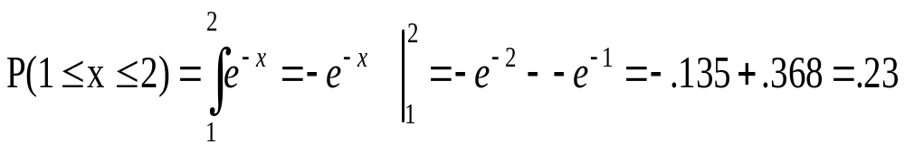
probability density function” (PDF) of Continuous case
Example: the probability of x falling within 1 to 2:
p(x)=e^{-x}
1
p(x)=e^{-x}
1
x
x
The probability that x is any exact particular value (such as 1.9976) is 0; we can only assign probabilities to possible ranges of x.
1
2

Slide 12




Covariance: joint probability
The covariance measures the strength of the linear relationship between two variables.
How much will a variable change when another variable changes.
The covariance:
Where,
is the ith observation in variable x,
is the mean for variable x,
is the ith observation in variable y,
is the mean for variable y, and
N is the number of observations

Slide 13
Interpreting Covariance
Covariance between two random variables:
cov(X,Y) > 0 X and Y are positively correlated
cov(X,Y) < 0 X and Y are inversely correlated
cov(X,Y) = 0 X and Y are independent

Slide 14
Covariance
Example:
Commercials Watched Product Purchases
0 10 13
1 15 0
2 7 7
3 2 4
4 16 11
The covariance between commercials watched and product purchases can be calculated manually and would produce the following results:
Variables:
Commercials Watched and Product Purchases Covariance (x, y) = ((10 - 10)(13 - 7) + (15 - 10)(0 - 7) + (7 - 10)(7 - 7) + (2 - 10)(4 - 7) + (16 - 10)(11 - 7)) / (5 - 1)
= 3.25

Slide 15

Correlation
Correlation overcomes the lack of scale dependency that is present in covariance by standardizing the values.
The equation for converting data to Z-scores is:
Where,
x_{i} is the i^{th} value for the variable,
is the mean for the variable, and
s_{x} is the standard deviation for the variable
Example :
Conducting the equation manually would produce the following result:
Variables: Commercials Watched and Product Purchases
r = ((10 - 10)(13 - 7) + (15 - 10)(0 - 7) + (7 - 10)(7 - 7) + (2 - 10)(4 - 7) + (16 - 10)(11 - 7)) / (5 - 1)(5.787918)(5.244044)
= 0.11

Slide 16
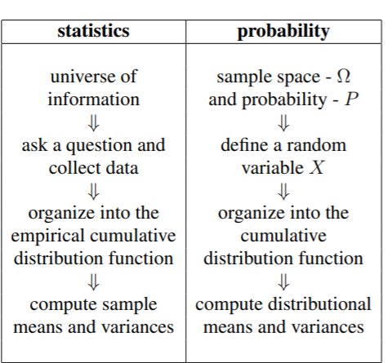
Stat vs Probability

